Slide 1



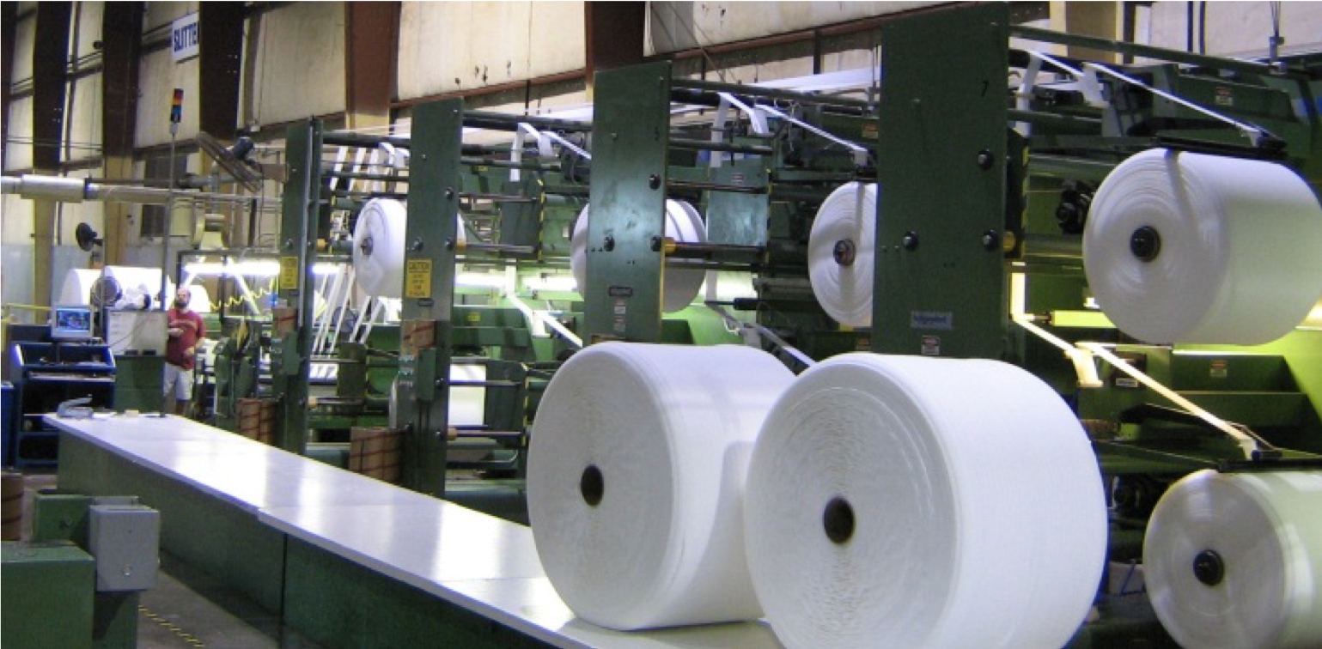
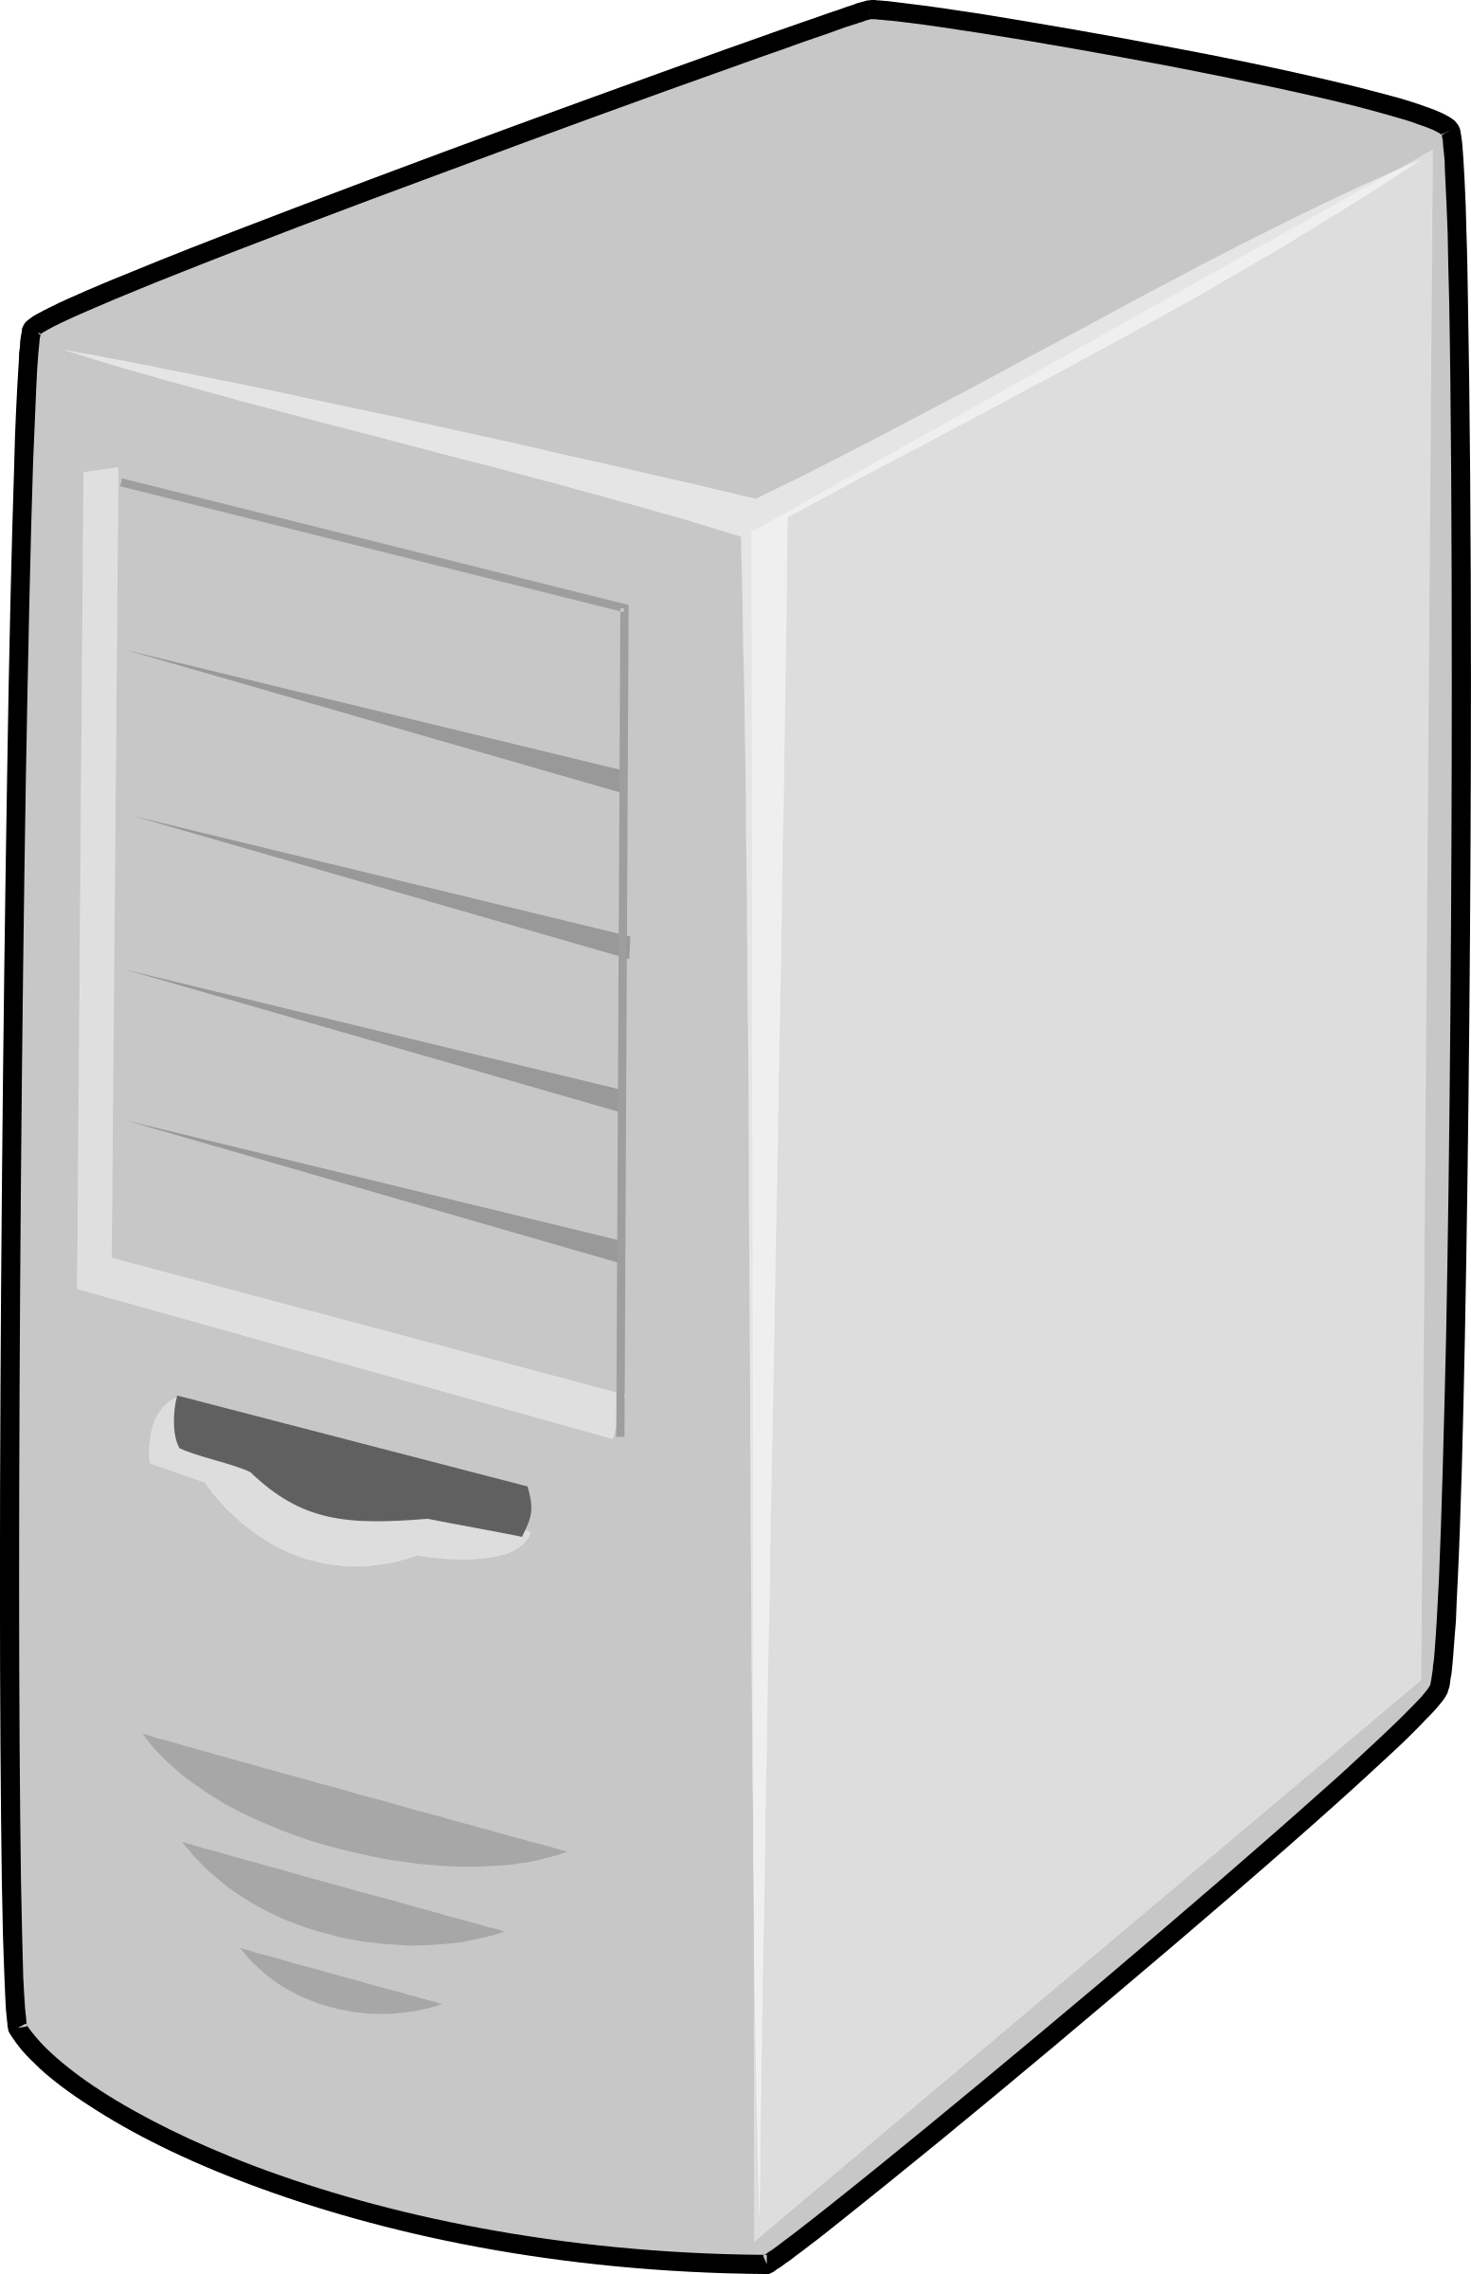
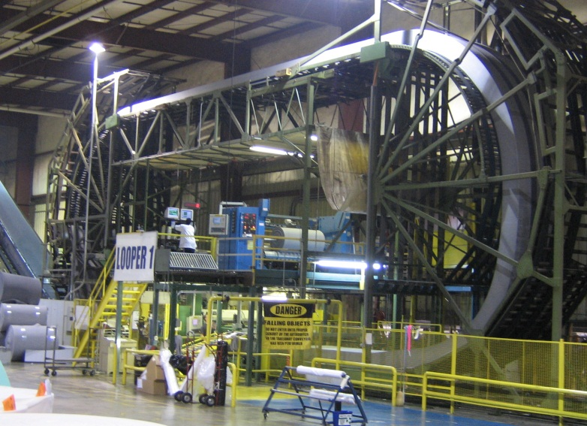
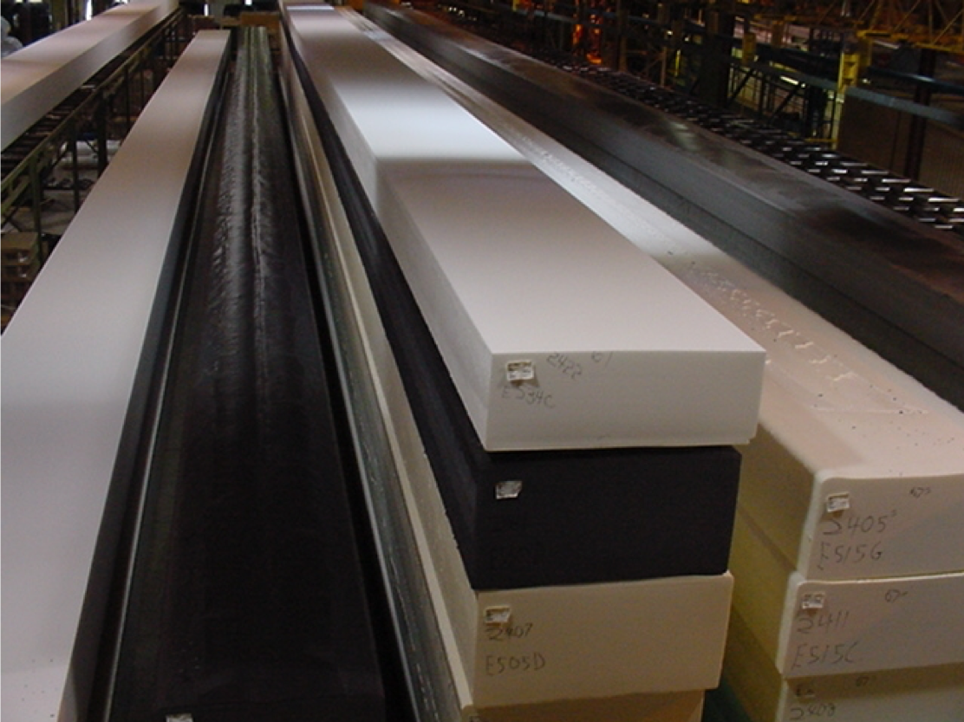
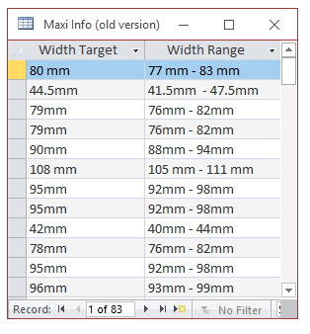

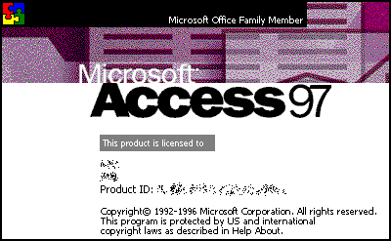
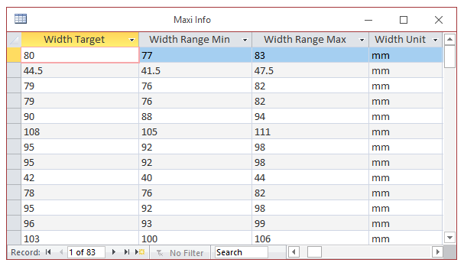

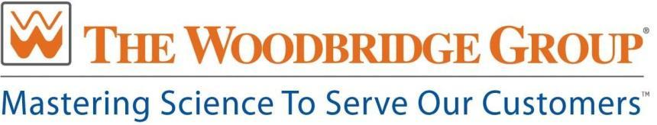
WFFI Tracker Database System
Javier Martinez, James Hare, Richard Kimsey, and Daniel Velasquez
Woodbridge Foam Fabricating Inc.
APRIL 20, 2018
Summary
Systex
Data Model
Requirements Specification
We have improved a Tracker Database System used by Woodbridge Foam Fabricating Inc. (WFFI). WFFI management decided that an update to Microsoft Access 2016 was beneficial for ease of use, to facilitate data transactions and to improve accountability. The features we implemented consisted of the following; we improved the windows login process, made audit table for logging and accountability, added triggers to the delete and login functionality to populate the audit tables, added restrictions on user input on the target width and height fields, and made it simpler to globally change the background logo.
Tracker
Database
Customers
Shipping
Project Database
Network
Dependencies
Tasks and Accomplishments
Machine Centers
Figure 3. Shows a machine center in the WFFI Chattanooga location where prioritized business requirements were gathered during the software requirements specification process.
Motivation
Build Audit Tables
Add Input Field Restrictions
Implement Microsoft Account login
Standardize Table Measurements
Add Triggers to Form Processes
Remove Unused Functionality
Record Database User Entries
Consolidate Instruction Tables
Update Form Logos
Change Report Form Layout
Results
We are proud to be part of a project that will benefit the employees who work with this business critical database everyday. Not only will this project help employees with their jobs, but it also helped our senior development team to better understand the Software Development Life Cycle and gain valuable experience in working to develop a software product for a customer.
Methods and Tools
Project Description
Software Requirements Specifications
Prioritized Business Requirements
The Woodbridge Foam Fabricating Inc. (WFFI) tracker database consists of 40 tables and 60 reports which are accessed daily by floor managers and employees to assist in the documentation of product quality at various stages in the manufacturing process.
Sprint Planning and Waterfall SDLC
Software Peer Reviews
Acknowledgements
QA & Regression Testing
Finalized deliverables to client
Figure 4. displays how a C# program was used to make conversions from text to numerical data

Slide 2
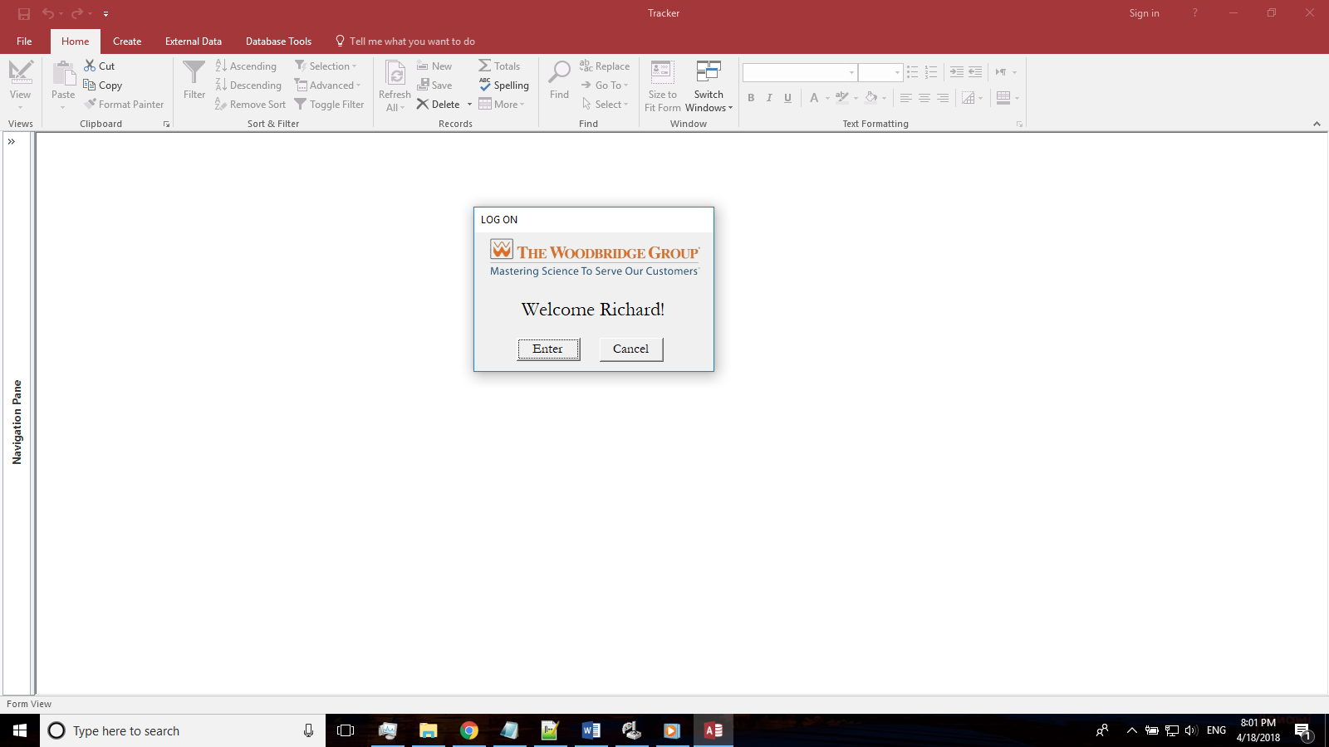

Slide 3
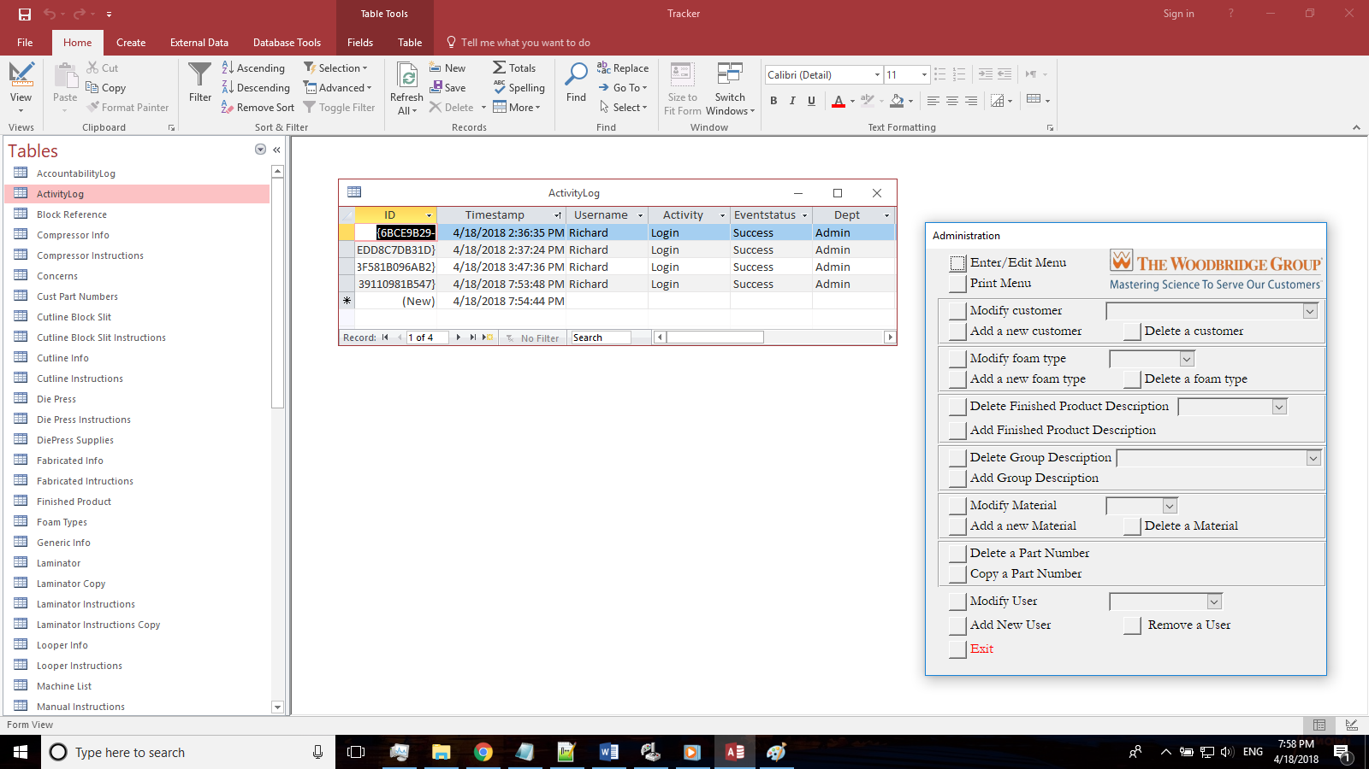

Slide 4
